Slide 1
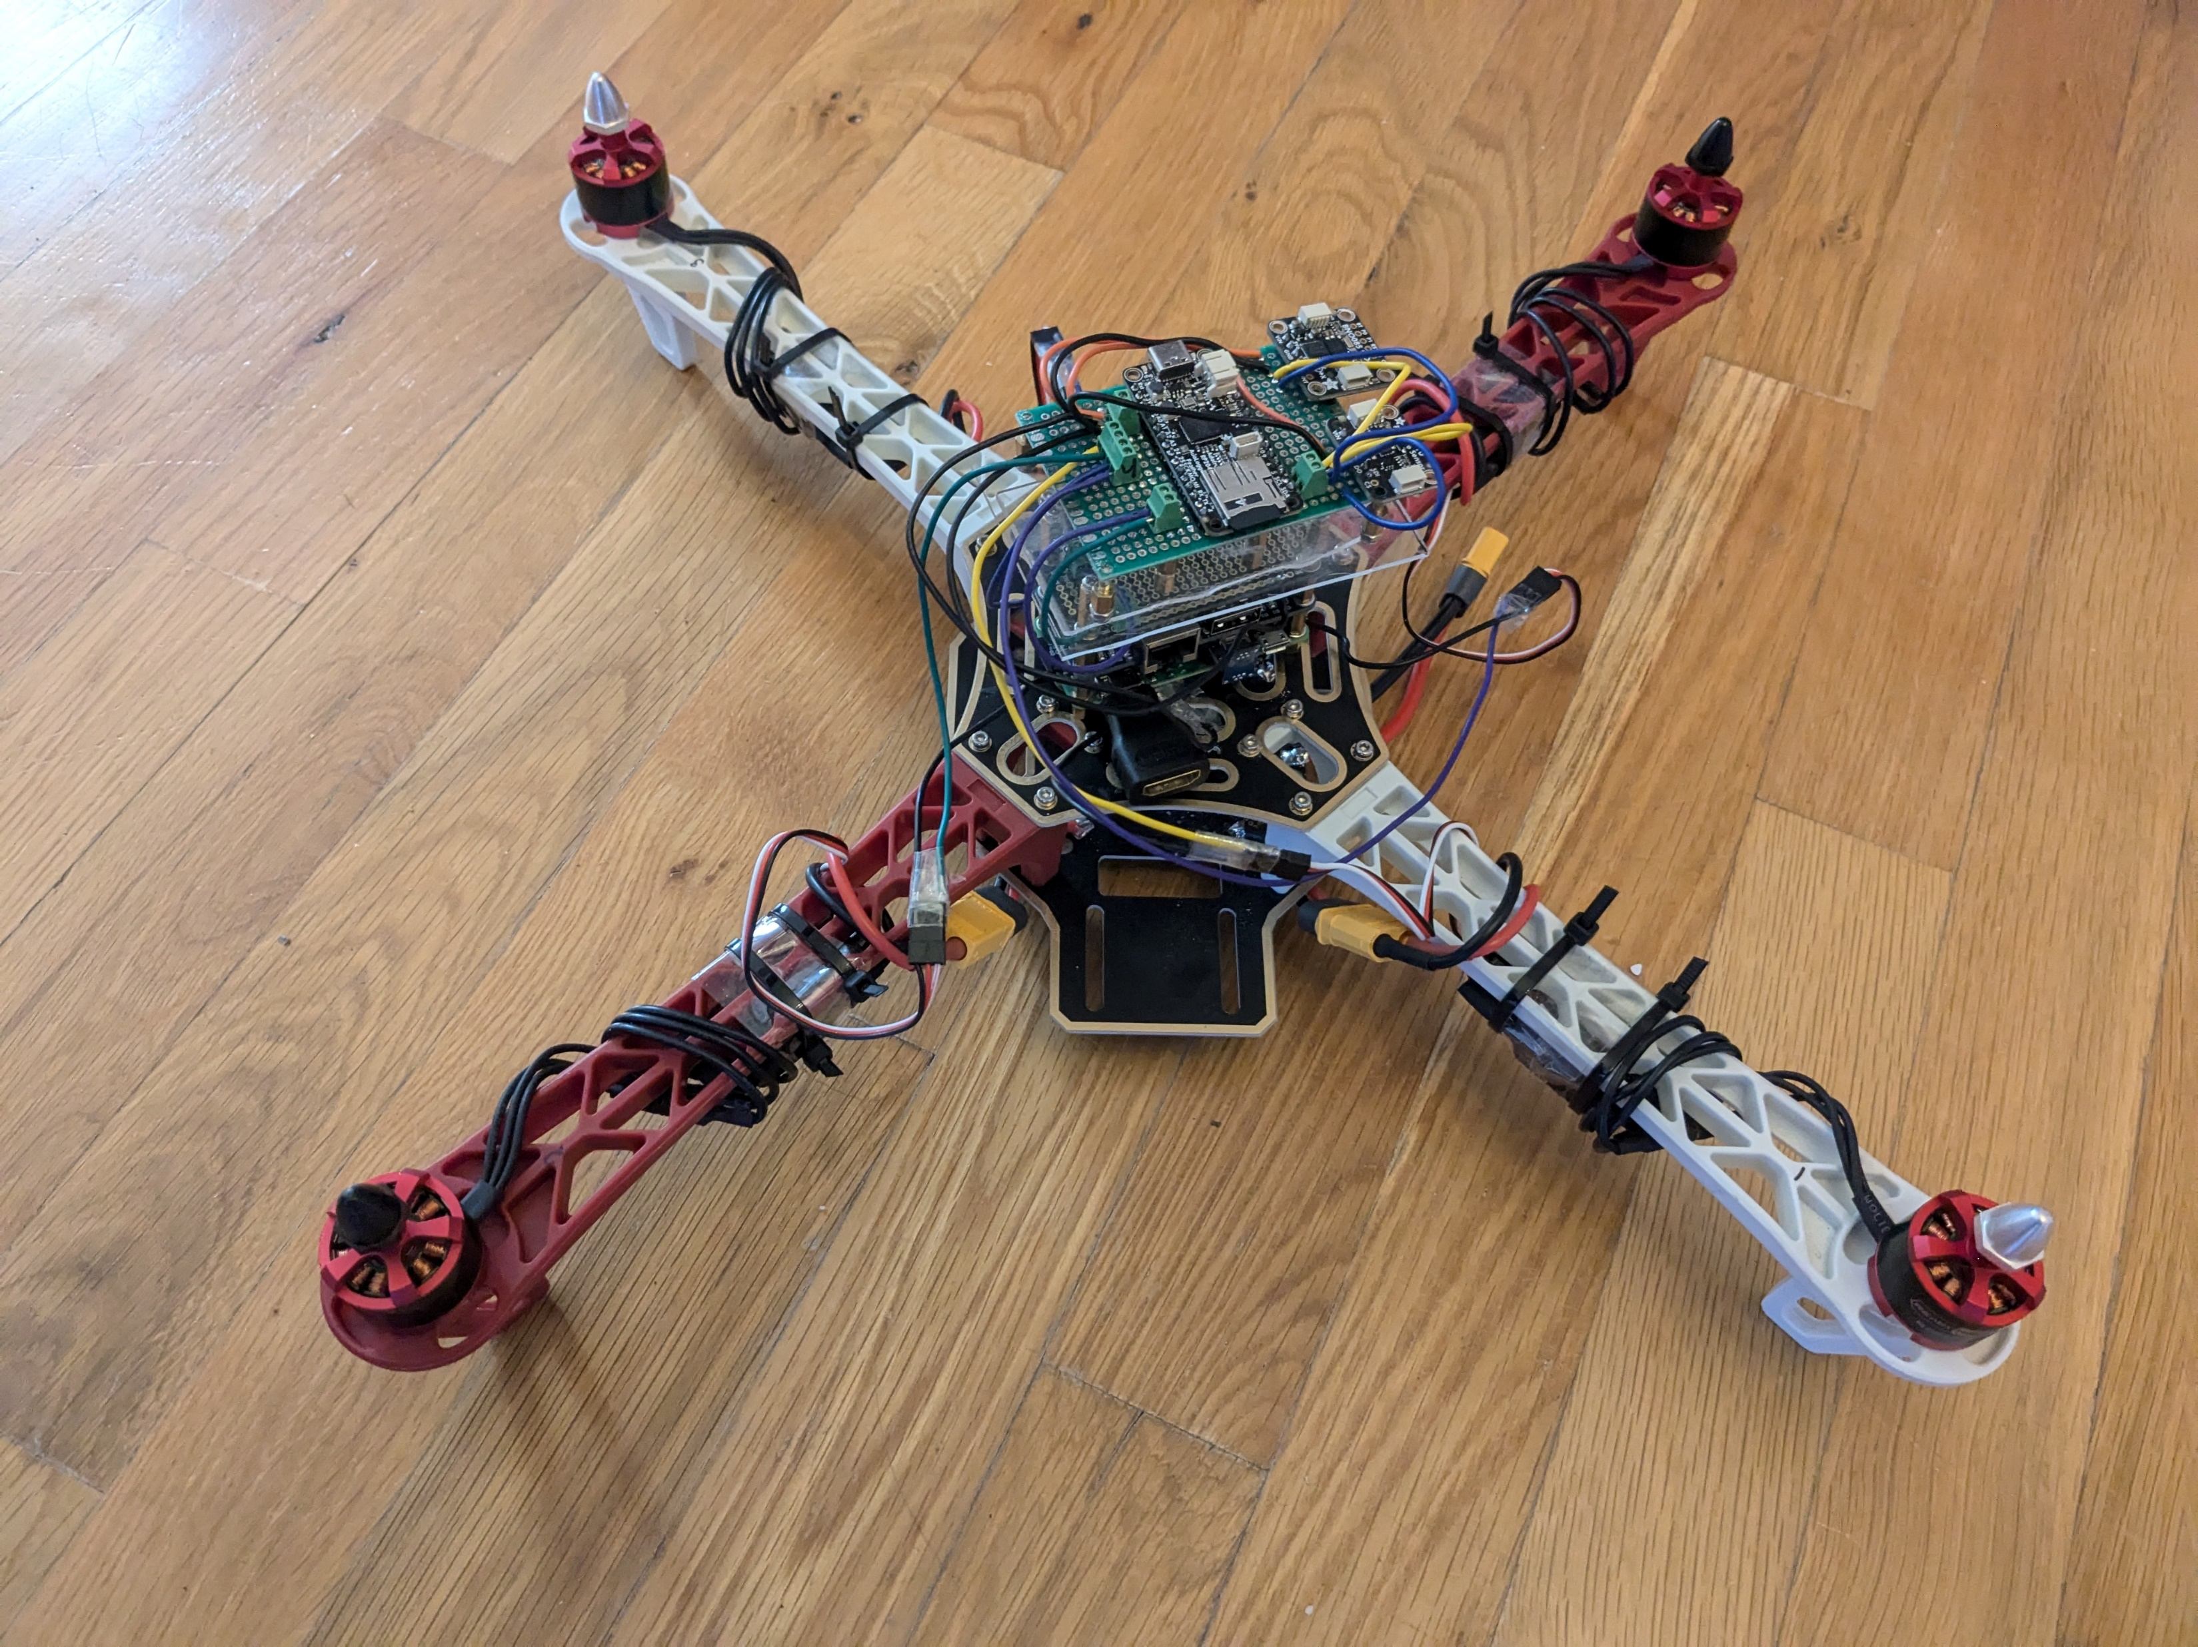
Quadcopter Project
Author: Zander Haws

Slide 2
Summary
Quadcopter Model
State-Space Equations
Electrical Architecture
Sensor Data Integration
PID Algorithms
Code Structure
GUI
Future Plans

Slide 3
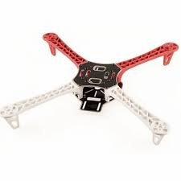



Quadcopter Model (1/5)
Coordinate Systems
$$z_{b}$$
Global Coordinate System
Axes:
X-axis (East)
Y-axis (North)
Z-axis (Up)
Origin:
Quadcopter position at start-up.
Body Coordinate System
Axes:
X-axis: Out quadcopter arm 2
Y-axis: Out quadcopter arm 3
Z-axis: Cross product of x and y axis (pointed up)
Origin:
Center of Gravity of Quadcopter
Up (z)
$$y_{b}$$
Body Coordinate
Frame
$$x_{b}$$
North (y)
East (x)
Inertial Coordinate Frame
3

Slide 4





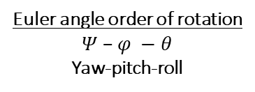


Quadcopter Model (2/5)
Inertial Coordinate System
$$z_{b}$$
Up (z)
6DOF Model
$$ψ$$
$$y_{b}$$
$$\left[\begin{matrix}\begin{matrix}\begin{matrix}x_{i} \\ y_{i}\end{matrix} \\ z_{i} \\ θ\end{matrix} \\ φ \\ ψ\end{matrix}\right]$$
$$φ$$
$$x_{b}$$
$$θ$$
North (y)
Euler angle order of rotation
$Ψ$– $φ −$ $θ$
Yaw-pitch-roll
East (x)
Inertial Coordinate Frame

Slide 5











Quadcopter Model (3/5)
Body Coordinate System
$$z_{b}$$
$$\left[\begin{matrix}\begin{matrix}\dot{x_{b}} \\ \dot{y_{b}} \\ \dot{z_{b}}\end{matrix} \\ \begin{matrix}\ddot{x_{b}} \\ \ddot{y_{b}} \\ \ddot{z_{b}}\end{matrix} \\ \begin{matrix}\dot{p} \\ \dot{q} \\ \begin{matrix}\dot{r} \\ \begin{matrix}\ddot{p} \\ \ddot{q} \\ \ddot{r}\end{matrix}\end{matrix}\end{matrix}\end{matrix}\right]$$
$$r$$
$$q$$
$$M1$$
$$y_{b}$$
$$M2$$
$$M4$$
$$p$$
$$M3$$
$$x_{b}$$

Slide 6

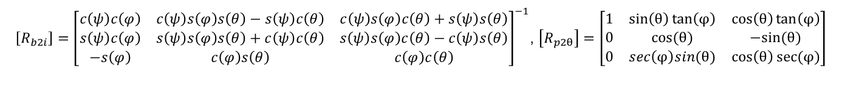
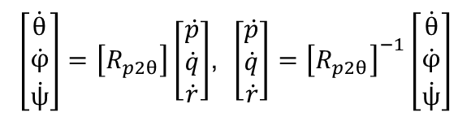
Quadcopter Model (4/5)
Body/Inertial Frame Transformation Equations
Position, Velocity and Acceleration Conversion Equations
$\left[\begin{matrix}x_{i} \\ y_{i} \\ z_{i}\end{matrix}\right]=\left[R_{b2i}\right]\left[\begin{matrix}x_{b} \\ y_{b} \\ z_{b}\end{matrix}\right], \left[\begin{matrix}x_{b} \\ y_{b} \\ z_{b}\end{matrix}\right]={\left[R_{b2i}\right]}^{−1}\left[\begin{matrix}x_{i} \\ y_{i} \\ z_{i}\end{matrix}\right]$
Euler Rates/Accelerations to Angular Rates/Accelerations Conversion
$\left[\begin{matrix}\dot{θ} \\ \dot{φ} \\ \dot{ψ}\end{matrix}\right]=\left[R_{p2θ}\right]\left[\begin{matrix}\dot{p} \\ \dot{q} \\ \dot{r}\end{matrix}\right]$, $\left[\begin{matrix}\dot{p} \\ \dot{q} \\ \dot{r}\end{matrix}\right]={\left[R_{p2θ}\right]}^{−1}\left[\begin{matrix}\dot{θ} \\ \dot{φ} \\ \dot{ψ}\end{matrix}\right]$
$\left[R_{b2i}\right]={\left[\begin{matrix}c\left(ψ\right)c\left(φ\right) & c\left(ψ\right)s\left(φ\right)s\left(θ\right)−s\left(ψ\right)c\left(θ\right) & c\left(ψ\right)s\left(φ\right)c\left(θ\right)+s\left(ψ\right)s\left(θ\right) \\ s\left(ψ\right)c\left(φ\right) & s\left(ψ\right)s\left(φ\right)s\left(θ\right)+c\left(ψ\right)c\left(θ\right) & s\left(ψ\right)s\left(φ\right)c\left(θ\right)−c\left(ψ\right)s\left(θ\right) \\ −s\left(φ\right) & c\left(φ\right)s\left(θ\right) & c\left(φ\right)c\left(θ\right)\end{matrix}\right]}^{−1}$, $\left[R_{p2θ}\right]=\left[\begin{matrix}1 & \sin\left(θ\right)\tan\left(φ\right) & \cos\left(θ\right)\tan\left(φ\right) \\ 0 & cos⁡(θ) & −sin⁡(θ) \\ 0 & sec\left(φ\right)sin(θ) & \cos\left(θ\right)sec⁡(φ)\end{matrix}\right]$

Slide 7


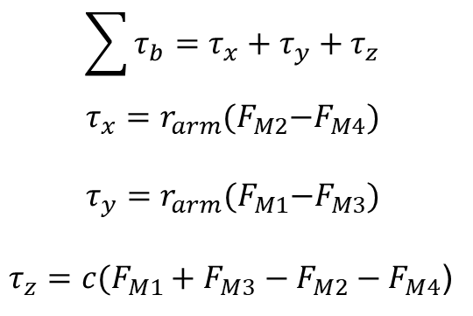





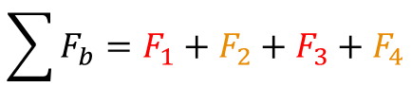




Quadcopter Model (5/5)
Rigid Body Dynamics in Body Frame
Force Summation
Torque Summation
$$\sum{F_{b}}=F_{1}+F_{2}+F_{3}+F_{4}$$
$$\sum{τ_{b}}=τ_{x}+τ_{y}+τ_{z}$$
$$τ_{x}=r_{arm}{(F}_{M2}−F_{M4})$$
$$τ_{y}=r_{arm}{(F}_{M1}−F_{M3})$$
$τ_{z}=c(F_{M1}+F_{M3}$ ${− F}_{M2}−F_{M4}$)
$$F_{1}$$
$$z_{b}$$
$$F_{2}$$
$$ω_{1}$$
$$y_{b}$$
$$F_{4}$$
$$ω_{2}$$
$$F_{3}$$
$$ω_{4}$$
$$ω_{3}$$
$$x_{b}$$
Notes:
C is force to moment scaling factor

Slide 8
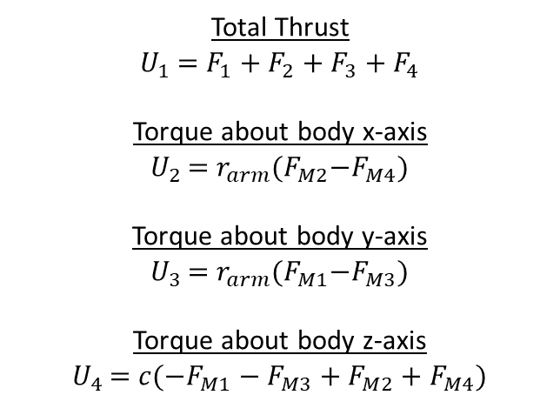
State-space Equations (1/3)
Quadcopter System Control Inputs
Total Thrust
$U_{1}$ = $F_{1}+F_{2}+F_{3}+F_{4}$
Torque about body x-axis
$U_{2}$ = $r_{arm}{(F}_{M2}−F_{M4})$
Torque about body y-axis
$U_{3}$ = $r_{arm}{(F}_{M1}−F_{M3})$
Torque about body z-axis
$U_{4}$ = $c(−F_{M1}−F_{M3}$ ${+ F}_{M2}+F_{M4}$)
Notes:
C is force to moment scaling factor

Slide 9

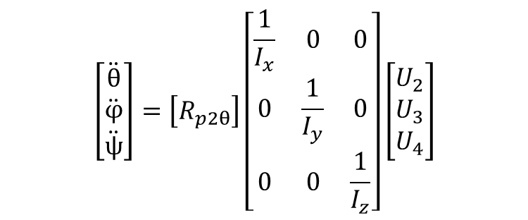
State-Space Equations (2/3)
System Dynamics from Control Inputs
$$\left[\begin{matrix}\ddot{x_{i}} \\ \ddot{y_{i}} \\ \ddot{z_{i}}\end{matrix}\right]=\left[R_{b2i}\right]\left[\begin{matrix}0 \\ 0 \\ 1\end{matrix}\right]\frac{U_{1}}{m}−\left[\begin{matrix}0 \\ 0 \\ g\end{matrix}\right]$$
$$\left[\begin{matrix}\ddot{θ} \\ \ddot{φ} \\ \ddot{ψ}\end{matrix}\right]=\left[R_{p2θ}\right]\left[\begin{matrix}\frac{1}{I_{x}} & 0 & 0 \\ 0 & \frac{1}{I_{y}} & 0 \\ 0 & 0 & \frac{1}{I_{z}}\end{matrix}\right]\left[\begin{matrix}U_{2} \\ U_{3} \\ U_{4}\end{matrix}\right]$$

Slide 10
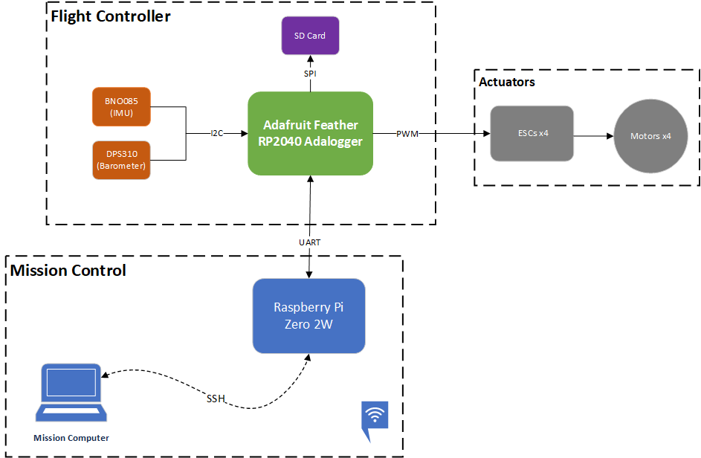
Electrical Architecture

Slide 11
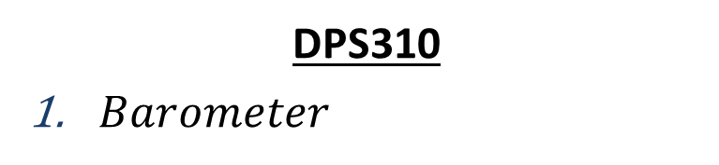

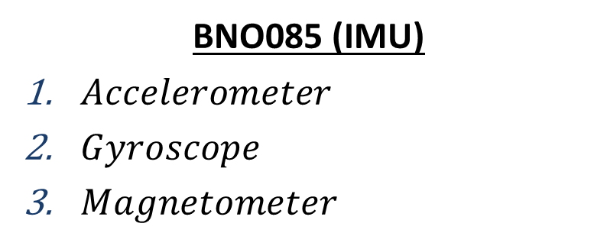



Sensor Data Integration (1/3)
Dynamical Data from Sensors
BNO085 (IMU)
$Accelerometer$
$Gyroscope$
$Magnetometer$
$${\ddot{x}}_{b},{\ddot{y}}_{b} , {\ddot{z}}_{b}$$
$$\dot{p}, \dot{q}, \dot{r}$$
$$θ, φ,ψ$$
Currently not yet fully integrated
DPS310
$Barometer$
$$z_{i}$$

Slide 12
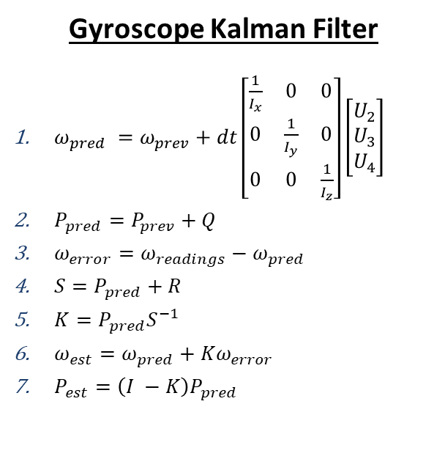
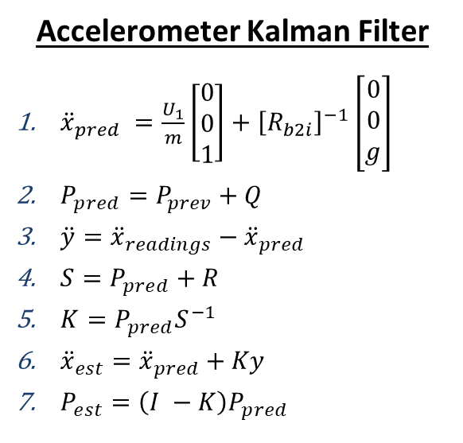
Sensor Data Integration (2/3)
Accelerometer and Gyroscope
Accelerometer Kalman Filter
${\ddot{x}}_{pred} =\frac{U_{1}}{m}\left[\begin{matrix}0 \\ 0 \\ 1\end{matrix}\right]+{\left[R_{b2i}\right]}^{−1}\left[\begin{matrix}0 \\ 0 \\ g\end{matrix}\right]$
$P_{pred}=P_{prev}+Q$
$\ddot{y}={\ddot{x}}_{readings}−{\ddot{x}}_{pred}$
$S=P_{pred}+R$
$K=P_{pred}S^{−1}$
${\ddot{x}}_{est}={\ddot{x}}_{pred}+Ky$
$P_{est}=\left(I −K\right)P_{pred}$
Gyroscope Kalman Filter
$ω_{pred} =ω_{prev}+dt\left[\begin{matrix}\frac{1}{I_{x}} & 0 & 0 \\ 0 & \frac{1}{I_{y}} & 0 \\ 0 & 0 & \frac{1}{I_{z}}\end{matrix}\right]\left[\begin{matrix}U_{2} \\ U_{3} \\ U_{4}\end{matrix}\right]$
$P_{pred}=P_{prev}+Q$
$ω_{error}=ω_{readings}−ω_{pred}$
$S=P_{pred}+R$
$K=P_{pred}S^{−1}$
$ω_{est}=ω_{pred}+Kω_{error}$
$P_{est}=\left(I −K\right)P_{pred}$

Slide 13
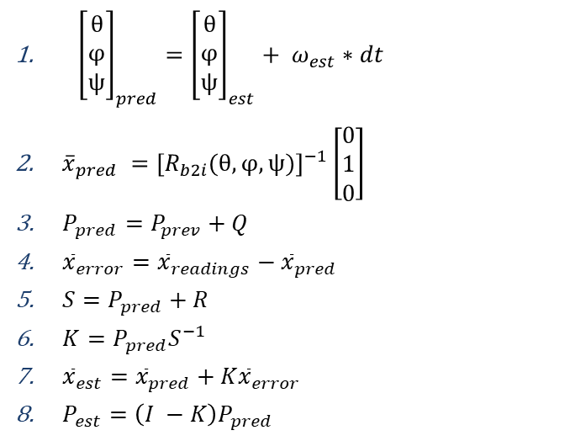
Kalman Filter (3/3)
Magnetometer
1. Kalman Filter
${\left[\begin{matrix}θ \\ φ \\ ψ\end{matrix}\right]}_{pred}={\left[\begin{matrix}θ \\ φ \\ ψ\end{matrix}\right]}_{est}+ ω_{est}∗dt$
${\overline{x}}_{pred} ={\left[R_{b2i}(θ, φ,ψ)\right]}^{−1}\left[\begin{matrix}0 \\ 1 \\ 0\end{matrix}\right]$
$P_{pred}=P_{prev}+Q$
${\overline{x}}_{error}={\overline{x}}_{readings}−{\overline{x}}_{pred}$
$S=P_{pred}+R$
$K=P_{pred}S^{−1}$
${\overline{x}}_{est}={\overline{x}}_{pred}+K{\overline{x}}_{error}$
$P_{est}=\left(I −K\right)P_{pred}$

Slide 14
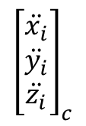
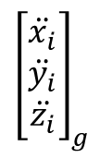
PID Algorithms (1/4)
Inertial Acceleration Control
$${\left[\begin{matrix}\ddot{x_{i}} \\ \ddot{y_{i}} \\ \ddot{z_{i}}\end{matrix}\right]}_{g}$$
PID Thrust
U1
$${\left[\begin{matrix}\ddot{x_{i}} \\ \ddot{y_{i}} \\ \ddot{z_{i}}\end{matrix}\right]}_{c}$$
PID Orientation
U2, U3, U4

Slide 15
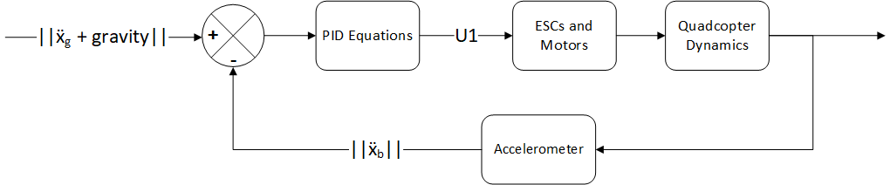
PID Algorithms (1/4)
PID Thrust

Slide 16
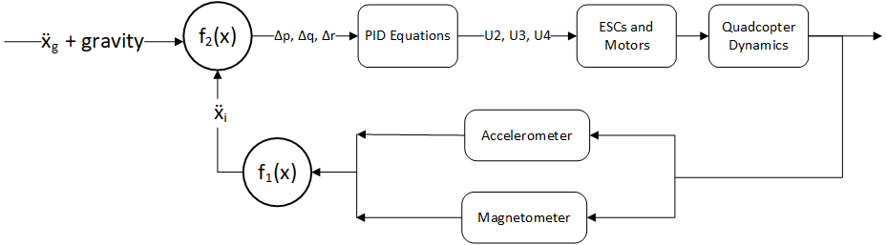
PID Algorithms (2/4)
PID Orientation (1/3)

Slide 17
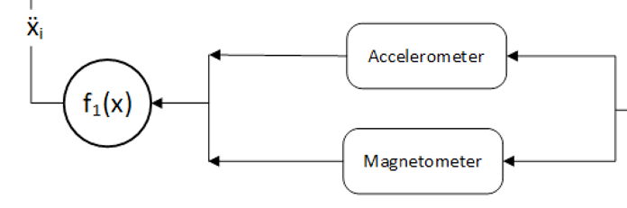

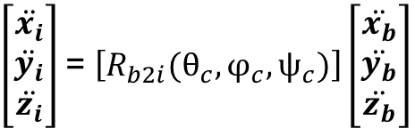
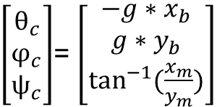

PID Algorithms (3/4)
PID Orientation (2/3)
$$f_{1}(<x_{m}, y_{m},z_{m}>, {<\ddot{x}}_{b},{\ddot{y}}_{b},{\ddot{z}}_{b}>)$$
$\left[\begin{matrix}θ_{c} \\ φ_{c} \\ ψ_{c}\end{matrix}\right]$= $\left[\begin{matrix}−g{∗x}_{b} \\ g{∗y}_{b} \\ \tan^{−1}{(\frac{x_{m}}{y_{m}})}\end{matrix}\right]$
$$1.$$
$\left[\begin{matrix}\ddot{x_{i}} \\ \ddot{y_{i}} \\ \ddot{z_{i}}\end{matrix}\right]$= $\left[R_{b2i}(θ_{c},φ_{c},ψ_{c})\right]\left[\begin{matrix}\ddot{x_{b}} \\ \ddot{y_{b}} \\ \ddot{z_{b}}\end{matrix}\right]$
$$2.$$

Slide 18
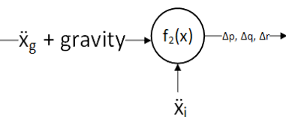







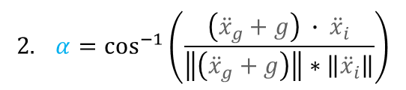
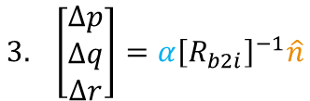
PID Algorithms (4/4)
PID Orientation (3/3)
$$f_{2}({\ddot{x}}_{g}+g, {\ddot{x}}_{i})$$
Inertial Vector Field
$$\ddot{x_{g}}+g$$
$$1. \hat{ n}=\frac{\left({\ddot{x}}_{g}+g\right) ×{\ddot{x}}_{i}}{\left\|\left({\ddot{x}}_{g}+g\right) ×{\ddot{x}}_{i}\right\|}$$
z
$$α$$
$$\ddot{x_{i}}$$
$$2. α=\cos^{−1}\left(\frac{\left({\ddot{x}}_{g}+g\right) ∙ {\ddot{x}}_{i}}{\left\|\left({\ddot{x}}_{g}+g\right)\right\|∗\left\|{\ddot{x}}_{i}\right\|}\right)$$
y
$$3. \left[\begin{matrix}∆p \\ ∆q \\ ∆r\end{matrix}\right]=α{\left[R_{b2i}\right]}^{−1}\hat{n}$$
$$\text{✓}$$
x
$$\hat{n}$$

Slide 19
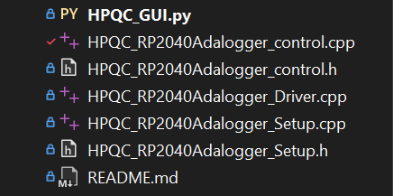
Code Structure
HPQC_GUI: Python GUI which opens a web browser interface with RPI Zero, allowing UART access from ground computer.
HPQC_control: Setup of Quadcopter class and all the corresponding control functions.
HPQC_Setup: Declaration of all the global variables and the functions needed during Power-on (e.g. I2C communications).
HPQC_Driver: Script that runs while the flight controller is on.

Slide 20
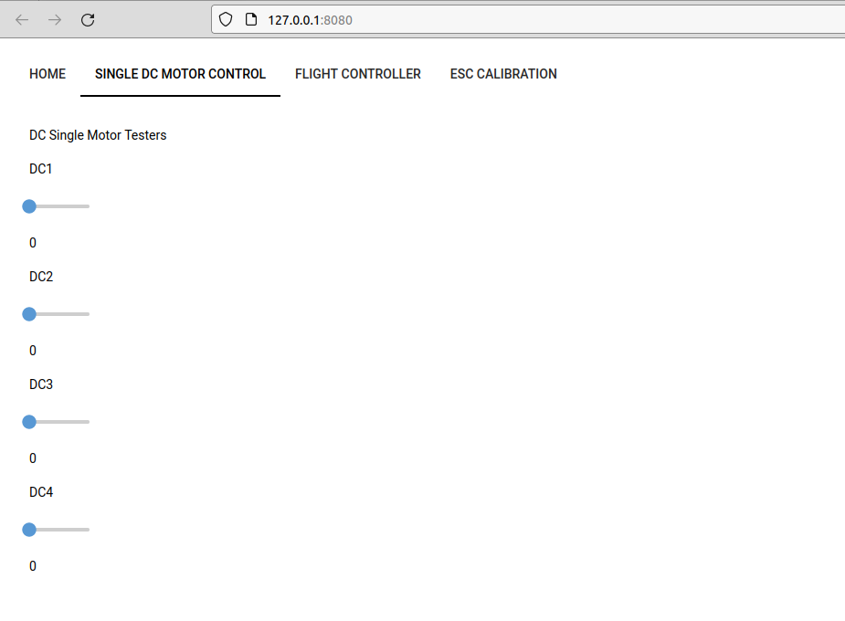
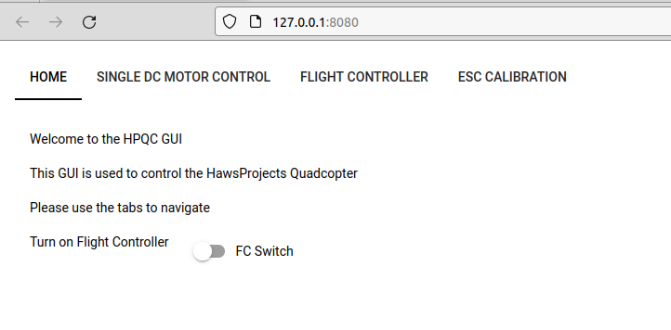
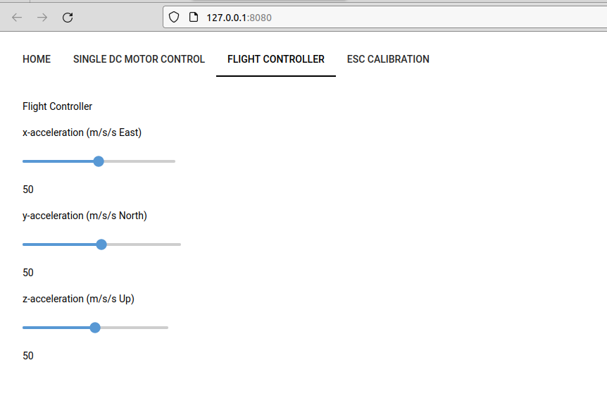
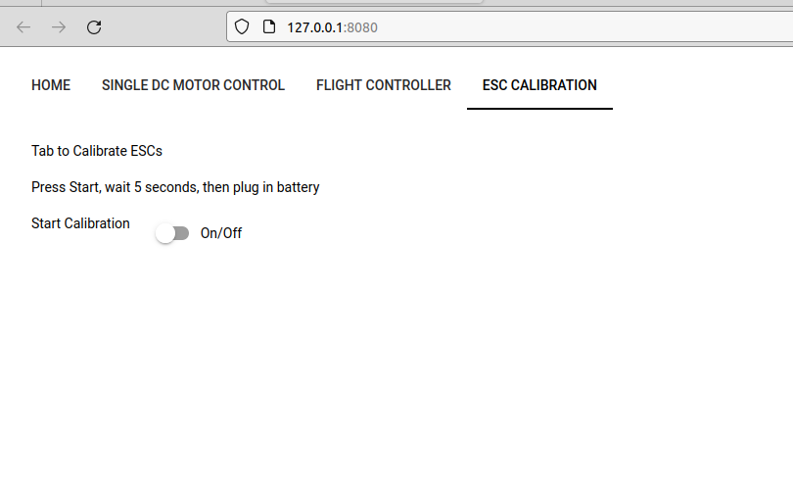
GUI
Tab 1
Tab 2
Tab 3
Tab 4

Slide 21
Future Plans
Near Future
Add velocity and position control modes
Integrate LiDAR sensor
Integrate GPS
Switch to extended Kalman filters
Expand GUI to have current data readings and different quadcopter modes
Far Future
Integrate a camera onto system, begin exploring computer vision
Explore autonomous route planning and decision making

Slide 22
Thanks!

